Slide 1
Packages and Interface

Slide 2
Packages
A package in Java is used to group related classes. Think of it as a folder in a file directory. We use packages to avoid name conflicts, and to write a better maintainable code. Packages are divided into two categories:
Built-in Packages (packages from the Java API)
User-defined Packages (create your own packages)
There are many built-in packages such as java, lang, awt, javax, swing, net, io, util, sql etc.

Slide 3
Advantage of Java Package
1) Java package is used to categorize the classes and interfaces so that they can be easily maintained.
2) Java package provides access protection.
3) Java package removes naming collision.
1. Built-in Packages
These packages consist of a large number of classes which are a part of Java API.Some of the commonly used built-in packages are:
java.lang: Contains language support classes(e.g classes which defines primitive data types, math operations). This package is automatically imported.
java.io: Contains classes for supporting input / output operations.
java.util: Contains utility classes which implement data structures like Linked List, Dictionary and support ; for Date / Time operations.

Slide 4
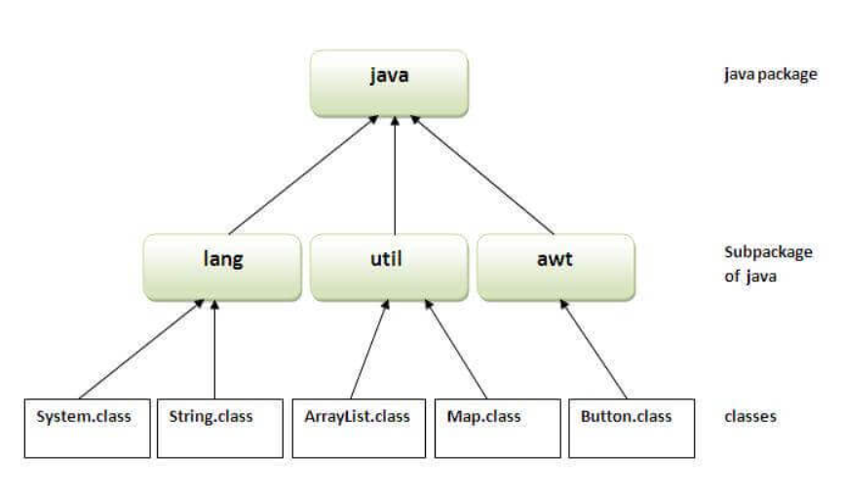
2. User-defined Packages
These are the packages that are defined by the user.
To create your own package, you need to understand that Java uses a file system directory to store them. Just like folders on your computer:

Slide 5
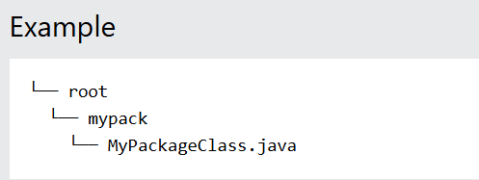
To create a package, use the package keyword:
package mypack;
class MyPackageClass {
public static void main(String[] args) {
System.out.println("This is my package!");
}
}

Slide 6
Save the file as MyPackageClass.java, and compile it:
javac -d . MyPackageClass.java
This forces the compiler to create the "mypack" package.
The -d keyword specifies the destination for where to save the class file.
The package name should be written in lower case to avoid conflict with class names.
When we compiled the package in the example above, a new folder was created, called "mypack".
To run the MyPackageClass.java file, write the following:
java mypack.MyPackageClass

Slide 7
How to access package from another package?
There are three ways to access the package from outside the package.
import package.*;
import package.classname;
fully qualified name.
1) Using packagename.*
If you use package.* then all the classes and interfaces of this package will be accessible but not subpackages.
The import keyword is used to make the classes and interface of another package accessible to the current package.

Slide 8
Example –
//save by A.java
package pack;
public class A{
public void msg(){System.out.println("Hello");}
}
//save by B.java
package mypack;
import pack.*;
class B{
public static void main(String args[]){
A obj = new A();
obj.msg();
}
}

Slide 9
Now first compile A.java –
javac -d . A.java
Compile B.java –
javac -d . B.java
Now run the B class file –
java mypack.B
2) Using packagename.classname
If you import package.classname then only declared class of this package will be accessible.

Slide 10
//save by A.java
package pack;
public class A{
public void msg(){System.out.println("Hello");}
}
//save by B.java
package mypack;
import pack.A;
class B{
public static void main(String args[]){
A obj = new A();
obj.msg();
}
}

Slide 11
3) Using fully qualified name
If you use fully qualified name then only declared class of this package will be accessible. Now there is no need to import. But you need to use fully qualified name every time when you are accessing the class or interface.
It is generally used when two packages have same class name e.g. java.util and java.sql packages contain Date class.

Slide 12
//save by A.java
package pack;
public class A{
public void msg(){System.out.println("Hello");}
}
//save by B.java
package mypack;
class B{
public static void main(String args[]){
pack.A obj = new pack.A();//using fully qualified name
obj.msg();
}
}
If you import a package, all the classes and interface of that package will be imported excluding the classes and interfaces of the subpackages. Hence, you need to import the subpackage as well.
Notes:
Note: If you import a package, subpackages will not be imported.

Slide 13
Subpackage in java
Package inside the package is called the subpackage. It should be created to categorize the package further.
Let's take an example, Sun Microsystem has definded a package named java that contains many classes like System, String, Reader, Writer, Socket etc. These classes represent a particular group e.g. Reader and Writer classes are for Input/Output operation, Socket and ServerSocket classes are for networking etc and so on. So, Sun has subcategorized the java package into subpackages such as lang, net, io etc. and put the Input/Output related classes in io package, Server and ServerSocket classes in net packages and so on.
The standard of defining package is domain.company.package e.g. com.chitkara.bean or org.sssit.dao.

Slide 14
Example –
package com.chitkara.core;
class Demo{
public static void main(String args[]){
System.out.println("Hello subpackage");
}
}
Compile it - java com.chitkara.core.Demo
Run it - java com.chitkara.core.Demo

Slide 15
Static Import in Java –
In Java, static import (import static) allows us to import static members (methods and variables) of a class directly, so we don't need to prefix them with the class name.
1. Without Static Import (Normal Way)
import java.lang.*; // optional as this is by default imported public class Main { public static void main(String[] args) { System.out.println(Math.sqrt(16)); // Using Math class name System.out.println(Math.PI); // Using Math class name } }
Notes:
Here, we must use Math.sqrt() and Math.PI, explicitly referring to the Math class.

Slide 16
2. With Static Import –
import static java.lang.Math.sqrt; // Importing static method import static java.lang.Math.PI; // Importing static variable public class Main { public static void main(String[] args) { System.out.println(sqrt(16)); // Using Math class name System.out.println(PI); // Using Math class name } }
Notes:
We can now use sqrt() and PI directly without referring to Math.

Slide 17
3. Importing All Static Members
Instead of importing specific members, we can import all static members of a class using:
import static java.lang.Math.*; // Importing all static members public class Main { public static void main(String[] args) { System.out.println(sqrt(16)); // Using Math class name System.out.println(PI); // Using Math class name } }

Slide 18
4. Using Static Import with User-Defined Classes –
package mypackage;
public class Utility {
public static void greet() {
System.out.println("Hello from Utility class!");
}
}

Slide 19
import static mypackage.Test.*; // Importing all static member fron Test
public class Test {
public static void main(String[] args) {
greet(); // Directly calling greet() without Utility.greet()
}
}
When to Use Static Import?
✔ When frequently using static members from a class. ✔ When improving code readability.
❌ Avoid overusing static import, as it can make code less readable if multiple classes have the same method names.

Slide 20
Interface
In Java, an interface is a blueprint of a class that contains only abstract methods (before Java 8) and static/final variables. It is used for achieving abstraction and multiple inheritance in Java
Key Characteristics of Interfaces
Only method declarations (No implementation before Java 8).
All methods are public and abstract by default.
Only static and final variables are allowed.
A class implements an interface using the implements keyword.
Supports multiple inheritance (A class can implement multiple interfaces).

Slide 21
Example –
// Define an interface
interface Animal {
void makeSound(); // Abstract method (public & abstract by default)
}
// Implementing the interface in a class
class Dog implements Animal {
public void makeSound() { // Must provide method definition
System.out.println("Dog barks: Woof Woof!");
}
}
public class InterfaceExample {
public static void main(String[] args) {
Dog dog = new Dog(); // Creating object of implementing class
dog.makeSound();
}
}

Slide 22
Interface with Multiple Implementing Classes
An interface can be implemented by multiple classes.
interface Vehicle {
void start();
}
// Class implementing Vehicle interface
class Car implements Vehicle {
public void start() {
System.out.println("Car starts with a key.");
}
}
// Another class implementing the same interface
class Bike implements Vehicle {
public void start() {
System.out.println("Bike starts with a self-start button.");
}
}
public class MultipleImplementation {
public static void main(String[] args) {
Vehicle myCar = new Car();
myCar.start();
Vehicle myBike = new Bike();
myBike.start();
}
}
Notes:
Output –
Car starts with a key.
Bike starts with a self-start button.

Slide 23
Interface Supporting Multiple Inheritance –
Unlike classes, Java does not support multiple inheritance with classes but allows multiple inheritance with interfaces.
Example –
interface Printable {
void print();
}
interface Showable {
void show();
}
// A class implementing multiple interfaces
class Document implements Printable, Showable {
public void print() {
System.out.println("Printing document...");
}
public void show() {
System.out.println("Showing document preview...");
}
}

Slide 24
public class MultipleInheritanceExample {
public static void main(String[] args) {
Document doc = new Document();
doc.print();
doc.show();
}
}
Notes:
Printing document...
Showing document preview...

Slide 25
Interface with Default and Static Methods (Java 8+) -
Before Java 8, interfaces could only have abstract methods, but from Java 8 onwards, they can have:
Default methods (with implementation)
Static methods (with implementation

Slide 26
Example –
interface MyInterface {
void show(); // Abstract method
// Default method with implementation
default void display() {
System.out.println("This is a default method in the interface.");
}
// Static method with implementation
static void staticMethod() {
System.out.println("This is a static method in the interface.");
}
}
// Implementing the interface
class MyClass implements MyInterface {
public void show() {
System.out.println("Implementing abstract method.");
}
}
public class InterfaceWithDefaultStatic {
public static void main(String[] args) {
MyClass obj = new MyClass();
obj.show();
obj.display(); // Calling default method
MyInterface.staticMethod(); // Calling static method (directly from interface)
}
}

Slide 27
Interface Variables (Final & Static) -
All variables in an interface are implicitly public, static, and final.
interface Constants {
int MAX_VALUE = 100; // Implicitly public, static, and final
}
public class InterfaceVariableExample {
public static void main(String[] args) {
System.out.println("Max Value: " + Constants.MAX_VALUE);
// Constants.MAX_VALUE = 200; // ERROR: Cannot change final variable
}
}

Slide 28
When to Use an Interface?
✔ When multiple classes need to share a common behavior but have different implementations. ✔ When achieving multiple inheritance is necessary. ✔ When designing loosely coupled systems (decoupling implementations from interfaces).

Slide 29
Why Did Java 8 Allow Method Bodies in Interfaces? 🤔
Before Java 8, interfaces in Java could only have abstract methods, meaning they could not have method implementations. However, Java 8 introduced default and static methods with method bodies in interfaces. This change was made to ensure backward compatibility and enhance flexibility in interface design.

Slide 30
. Backward Compatibility (Avoiding API Breakage)
🔸Before Java 8, adding a new method to an interface broke all implementing classes because they would have to provide an implementation for the new method.
🔸 Solution in Java 8:
Default methods allow interface designers to add new methods without breaking existing implementations.
interface Vehicle {
void start();
}
// Suppose we add a new method
interface Vehicle {
void start();
void stop(); // This breaks all implementing classes!
}
All existing classes implementing Vehicle would break!

Slide 31
Solution –
interface Vehicle {
void start(); // Abstract method
// New default method added without breaking existing classes
default void stop() {
System.out.println("Vehicle stopping...");
}
}
Now, existing classes will continue to work, as they are not forced to override stop().

Slide 32
Allowing Code Reusability in Interfaces -
Before Java 8, common functionality had to be implemented in each class separately.
Now, with default methods, the common functionality can be written once in the interface and reused.
Example: Without Default Methods (Before Java 8)
interface Printer {
void print();
}
class InkjetPrinter implements Printer {
public void print() {
System.out.println("Printing using Inkjet Printer...");
}
}
class LaserPrinter implements Printer {
public void print() {
System.out.println("Printing using Laser Printer...");
}
}
// If we want a new feature like duplex printing, we must implement it in each class.

Slide 33
Each class must implement duplicate code separately.
With Java 8 Default Methods (Code Reusability) –
interface Printer {
void print();
// Default method for duplex printing
default void duplexPrint() {
System.out.println("Printing on both sides...");
}
}
class InkjetPrinter implements Printer {
public void print() {
System.out.println("Printing using Inkjet Printer...");
}
}
class LaserPrinter implements Printer {
public void print() {
System.out.println("Printing using Laser Printer...");
}
}
public class DefaultMethodExample {
public static void main(String[] args) {
Printer inkjet = new InkjetPrinter();
inkjet.print();
inkjet.duplexPrint(); // Using default method without overriding
Printer laser = new LaserPrinter();
laser.print();
laser.duplexPrint();
}
}

Slide 34
Allowing Utility Methods in Interfaces (static methods) -
Before Java 8, utility methods (helper functions) had to be placed in separate utility classes like Collections or Arrays.
Now, static methods in interfaces allow utility functions to be directly placed inside interfaces.
Example: Static Method in Interface

Slide 35
interface MathOperations {
static int add(int a, int b) { // Static method in interface
return a + b;
}
}
public class StaticMethodExample {
public static void main(String[] args) {
System.out.println(MathOperations.add(5, 3)); // Calling static method
}
}
No need for a separate utility class!

